Slide 1

STARBUCKS™

Slide 2
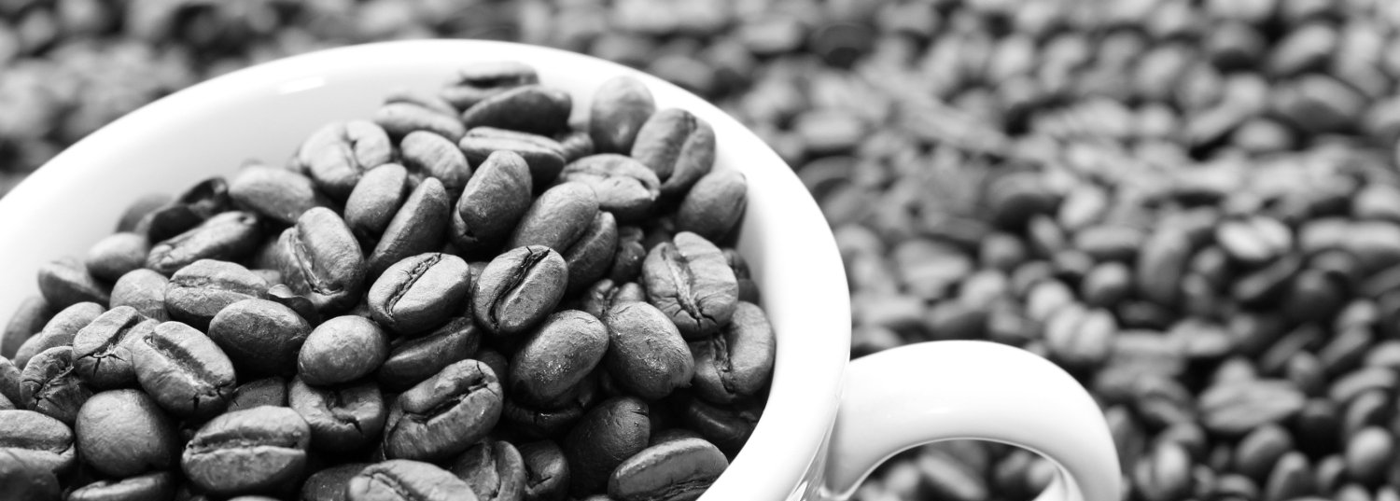

PROJECT STORY
The newly assigned London Branch Manager, Ms. Edna Ceniza, was asked for suggestions to
improve the existing system for Starbucks in order to sky rocket income and sales.
Little did they know, Edna is very knowledgeable with PHP and Javascript Programming. Like Super knowledgeable.
With that, Edna has requested you her friends back in the Philippines to help her out make her vision to a reality.
Edna’s idea is to create an automated system of requesting an order thru a Web Application so that the Customer would just have to pick it up from the nearest Starbucks branch.

Slide 3
PROJECT STORY
To start the application, the user will provide their Complete name and the customer can then proceed to the selection of Consumables they are shown so that they can order one or many of the available consumables.
The Consumables are categorized as Beverage and Food.
After the Ordering process. The customer will then click the submit button to generate a Receipt-like interface. So that, they’ll know how much is the total costs of all selected products.

Slide 4

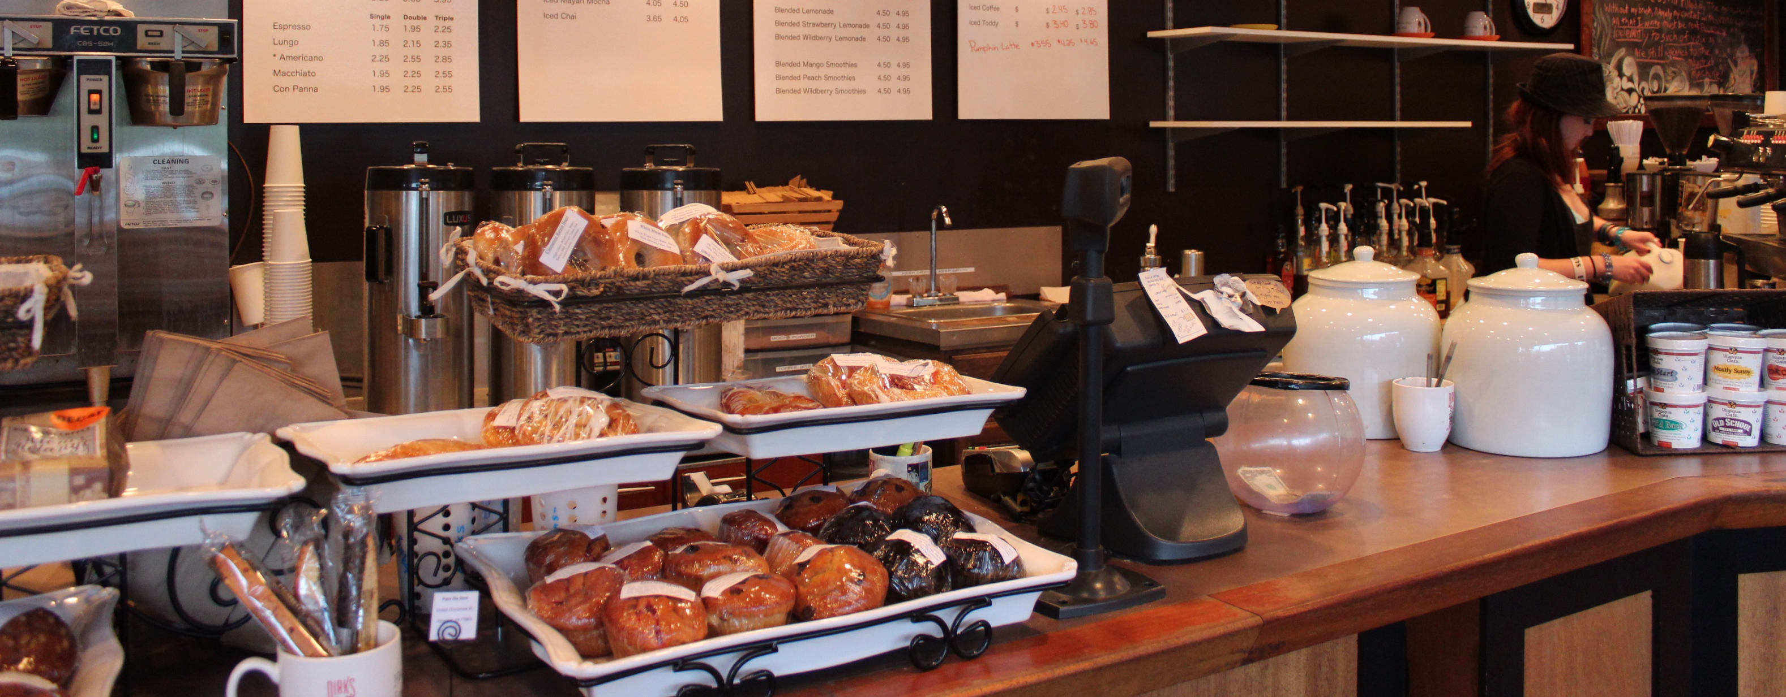
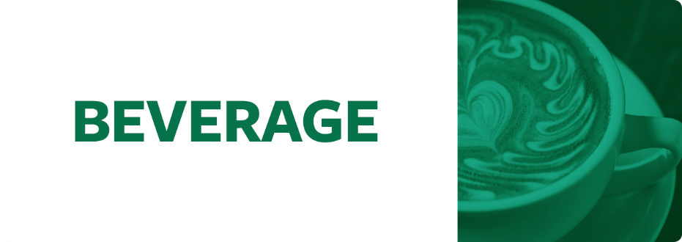
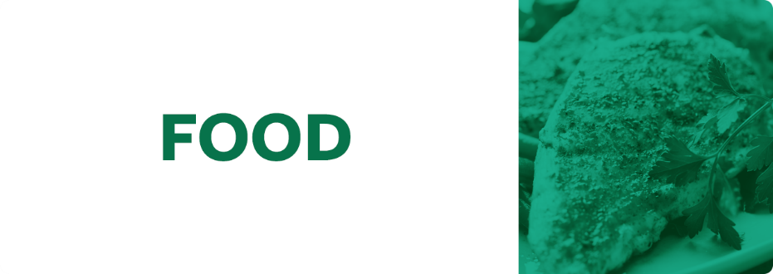
CLASS HEIRARCHY

Slide 5
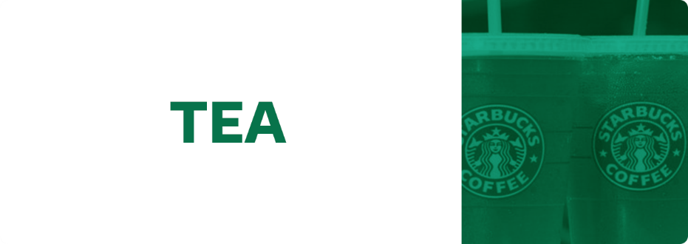
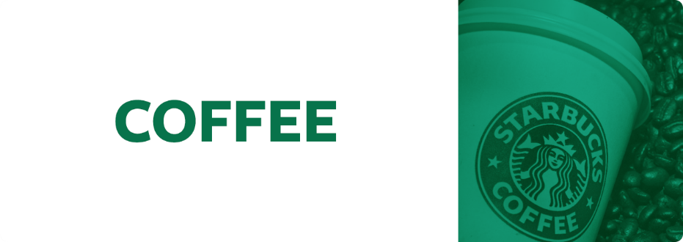
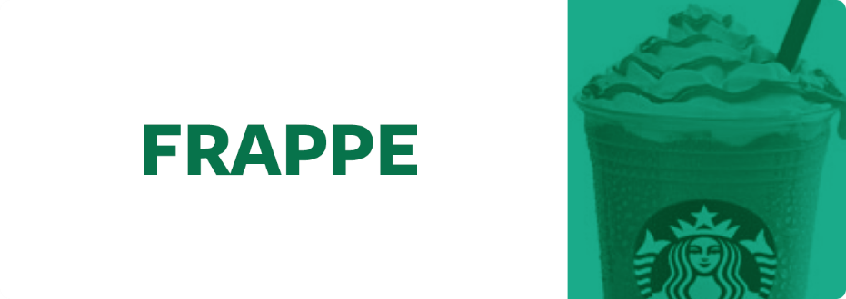
CLASS HEIRARCHY

Slide 6

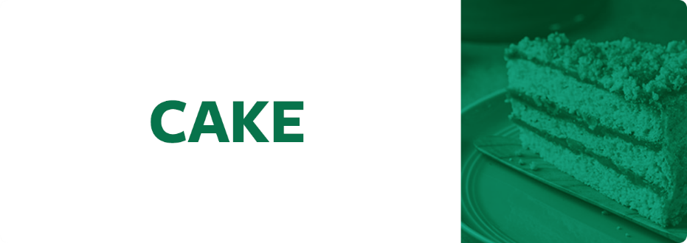

CLASS HEIRARCHY

